Slide 1
STERLING E-COMMERCE CUSTOMER PURCHASE BEHAVIOR DASHBOARD
A 10Alytics
Excel Capstone Project – Group 5
Full Stack Data Science
(April, 2024 Cohort)

Slide 2
Project Introduction
The Director of Sterling E-Commerce reached out to our team of four data scientists to harness the potential of their data. Sterling aims to gain deeper insights into customer needs, preferences, and behaviors. By identifying patterns and trends, they hope to make informed decisions that will:
Optimize product offerings,
Streamline operations, and
Enhance the overall customer experience.
Our project focuses on creating an Excel dashboard to visualize customer purchase behavior and provide actionable insights to achieve these goals.

Slide 3
Project Scope
Exploratory Data Analysis (EDA): To collect, clean, and profile Sterling E-Commerce Customer dataset to ensure accuracy and consistency while identifying preliminary trends and patterns to inform dashboard development.
Model Development with Excel: To define KPIs and create pivot tables to extract key metrics and visualize trends in customer purchase behavior across various dimensions such as growth trend, product category, location, gender, and payment method.
Excel Dashboard Evaluation: To validate visualization accuracy and add Slicers to optimize performance and ensure usability and effectiveness.

Slide 4
Project Team
Omotola Akinola.
Kenneth Onochie.
Ifechukwu Akaeze.
Osita Okeke.

Slide 5
Our Data Story
Sterling E-Commerce, a leading online retailer, offers a diverse range of products across multiple categories. To maintain its competitive edge and enhance the customer experience, the company seeks to leverage data insights to understand customer preferences, and behavior, optimize product offerings, and streamline operations.
Our goal was to analyze Sterling's customer purchase behavior to identify patterns, trends, and actionable insights. This understanding will support more informed decision-making to optimize product offerings, streamline operations, and improve the overall customer experience.

Slide 6
Our Data Story
We cleaned and prepared Sterling's dataset by trimming and properly formatting data, filling blanks, categorizing variables using VLOOKUP, removing duplicates, and formatting as Table. This process ensured the data was accurate and ready for analysis.
Finally, after cleaning and preparing the dataset, we collaboratively created pivot tables to summarize, analyze the data, and generate insights on key metrics.

Slide 7
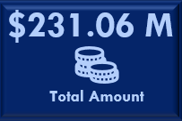
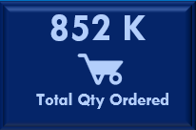
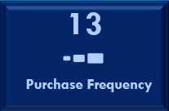
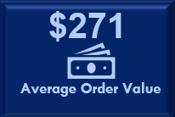
Our Data Story
Our Key insights from the customer purchase behavior dashboard include:
Total Purchase KPIs:
Total Purchase Amount: Sterling E-Commerce generated a total revenue of $231.06 million within the period (Nov. 2021 – Sept. 2022).
Total Quantity Ordered: Customers ordered a total of 852,000 units within the period (Nov. 2021 – Sept. 2022).
Purchase Frequency: On average, customers placed 13 orders.
Average Order Value: The average order value stood at $271..

Slide 8
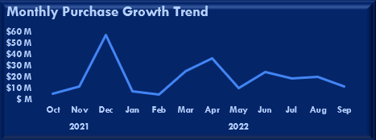
Our Data Story
Our Key insights from the customer purchase behavior dashboard include:
Other Metrics:
Monthly Purchase Growth Trend: Revealed a significant increase in purchase amount from October 2021 to December 2021, followed by fluctuations in subsequent months.

Slide 9
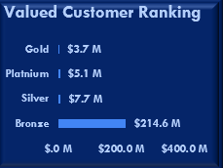
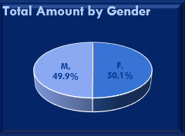
Our Data Story
Our Key insights from the customer purchase behavior dashboard include:
Other Metrics:
Valued Customer Ranking: Identified highest-ranking customers with varying purchase amounts, categorized into Bronze, Silver, Gold, and Platinum tiers.
Purchase Behavior by Gender: Showed a nearly equal distribution of purchases between male and female customers.

Slide 10
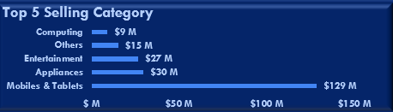
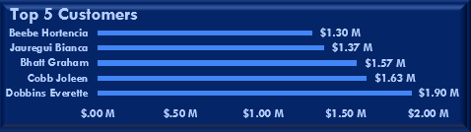
Our Data Story
Our Key insights from the customer purchase behavior dashboard include:
Other Metrics:
Top Selling Categories: Highlighted Mobiles & Tablets as the top-selling category, followed by Appliances, Entertainment, and others.
Top Customers: Identified the top five highest-spending customers, showcasing their significant contribution to total sales.

Slide 11
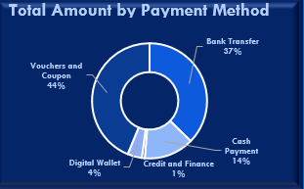
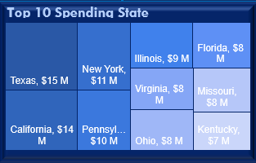
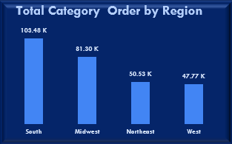
Our Data Story
Our Key insights from the customer purchase behavior dashboard include:
Other Metrics:
Purchase Distribution by Payment Method: Illustrated the prevalence of Vouchers and Coupons as the preferred payment method among customers.
Spending Analysis by States: Identified top-spending states, providing insights into geographic preferences and market potential.
Product Category Distribution by Region: Demonstrated varying product category preferences across different regions, with the South region leading in total purchases.

Slide 12
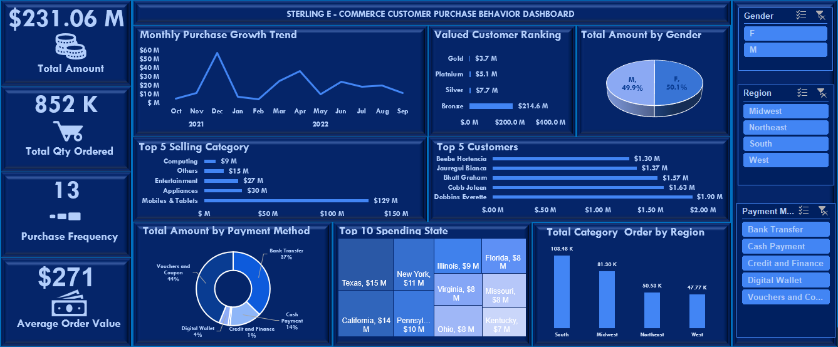
Comprehensive Customer Purchase Behavior Dashboard
O

Slide 13
Conclusion
In conclusion, our team of data scientists has successfully developed a comprehensive Excel dashboard that provides valuable insights into Sterling E-Commerce's customer purchase behavior. By leveraging this dashboard, Sterling can make data-driven decisions to optimize product offerings, streamline operations, and enhance the customer experience.
We are confident that the insights presented will empower Sterling E-Commerce to better understand their customers and improve business efficiency.

